Slide 1


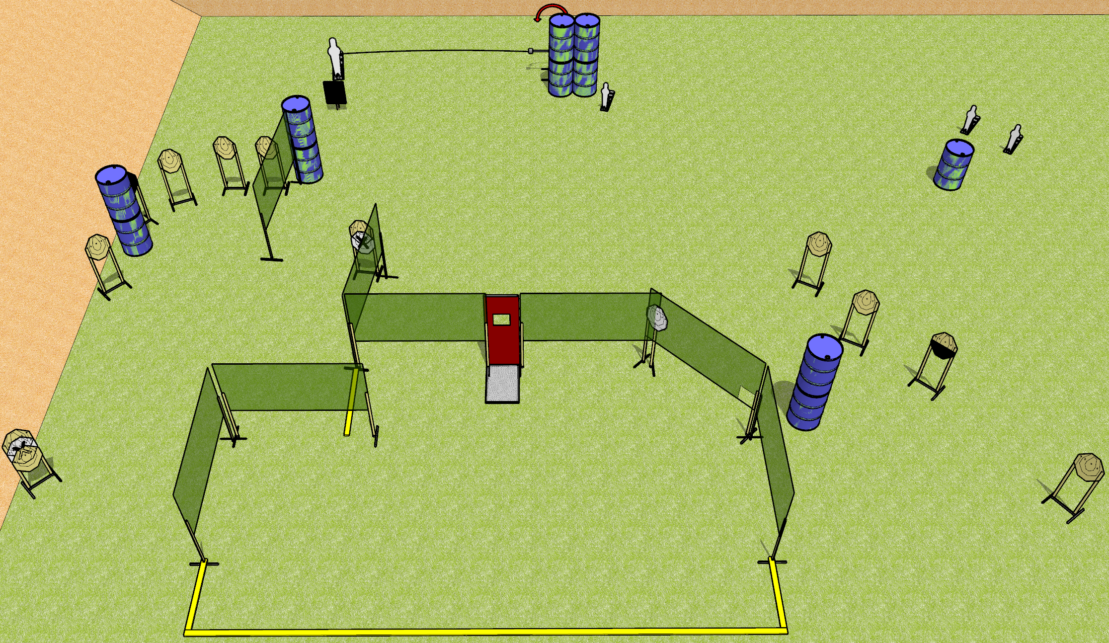
 | Dothan Gun Club – USPSA Match Window to the Soul Course Designer : Drew Coleman
START POSITION : Standing anywhere completely outside the shooting area. Hands relaxed at sides.
GUN READY CONDITION : Pistol loaded and holstered. PCC buttstock on belt, barrel perpendicular to back berm. |  | SCORING: Comstock, 30 rounds TARGETS: 13 paper, 4 Steel SCORED HITS: Best 2 on paper, steel until down START-STOP: Audible, last shot RULES:
STAGE PROCEDURE: Engage targets as they become available from within the fault lines

